Slide 1

Mahindra First Choice Services
Presented by :
Vishnu Sreenivasan
Quid Morbiwala
Karan Pande
Hemant Gupta

Slide 2
Business Problem
Geolocation Based Analysis:
Extract insights regarding the ownership pattern of cars based on location features of the customers.
Find out how the different type of services and service time vary with location.
Analyse the revenue generated at different locations throughout the country
Market Segmentation:
Divide the customer base into different segments based on the activeness, number of visits to garage, service type and revenue generated .
This will help to better understand the customer behavioural patterns and have targeted marketing campaigns and rewards based on the segments
Customer Lifetime Value Prediction:
Predict the value given by the customer over his lifetime based on the average spend over a year and number of visits.
Analysing CLV would help Mahindra First Choice focus on the customers who are going to generate good value to the company.

Slide 3

Exploratory Data Analysis
Lets Start with the first steps of Visualizations

Slide 4
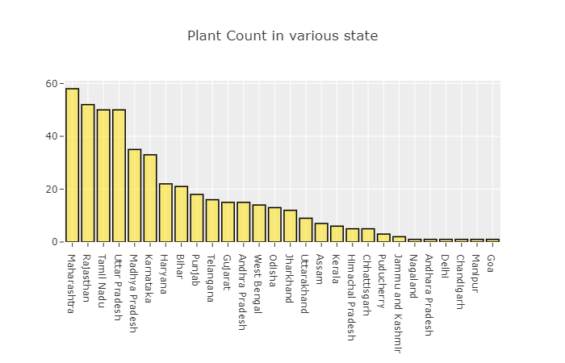
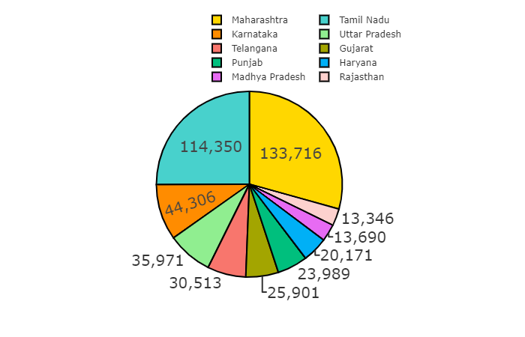
Geolocation Analysis
Plant count vs car count
Maharashtra, Rajasthan, Tamil Nadu, UP,MP tops in number of plants
Maha,TN, Karnataka, UP, Telangana tops in car count
Plants vs car count is very less in states like Karnataka, Telangana
Possible reasons could be car owners in Karnataka ,Telangana are more as compared to other states
On the other hand Rajasthan is 2nd in terms of count but the car count is very less.
Possible reasons could be customers shift to other service provider or car owners are less in this state as compared to other states

Slide 5
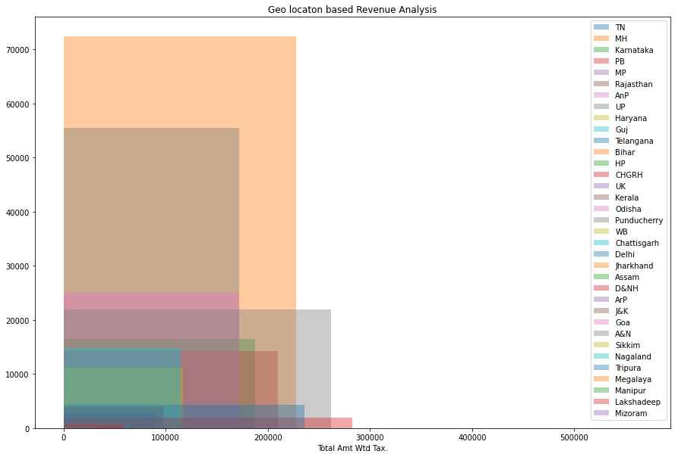
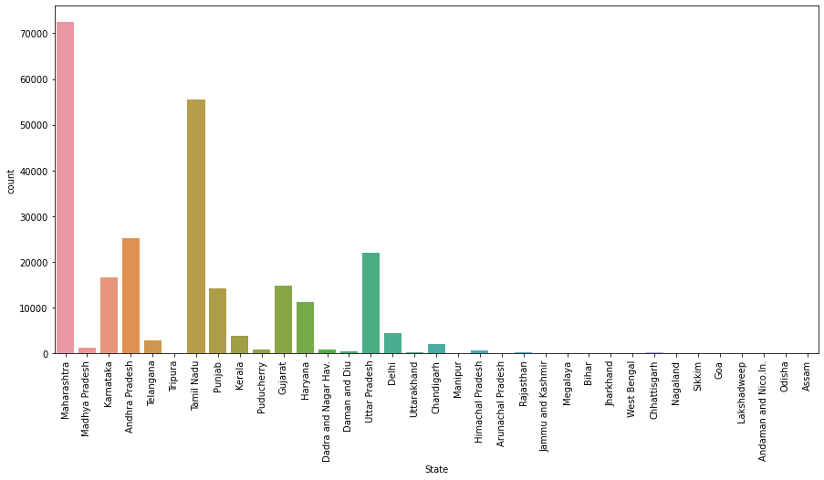
Which state has most revenue?
Maharashtra has highest customer base followed by Tamil Nadu.
Top 3 revenue generating states are MH TN AP

Slide 6
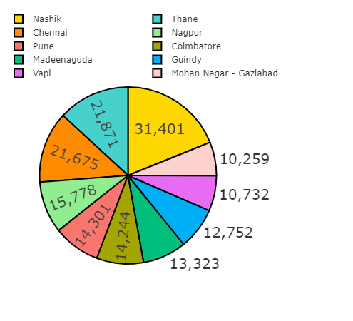
Which city has most revenue
Top 5 cities given above top the list, this is obvious as they are top major metropolitan cities in India
Nashik(31,401)
Thane(21,871)
Chennai(21,675)
Nagpur(15,778)
Pune(14,301)

Slide 7
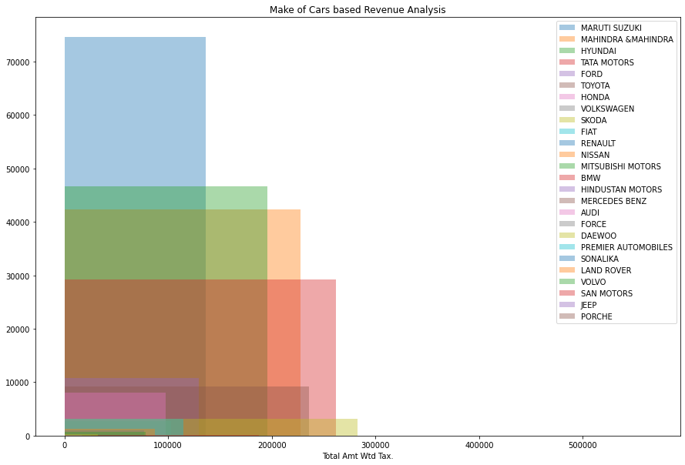
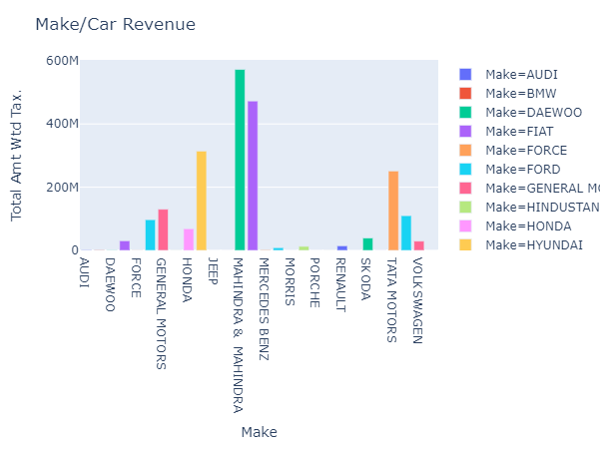
Which make/car is more popular?
M&M contributed the most towards revenue ,followed by Maruti Suzuki, Hyundai, Tata Motors
Meanwhile, Maruti Suzuki tops on the basis of count but the revenue produced is less as compared to Mahindra and Mahindra
Make of Cars based Revenue Analysis

Slide 8
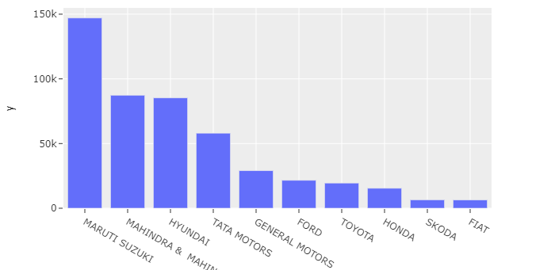
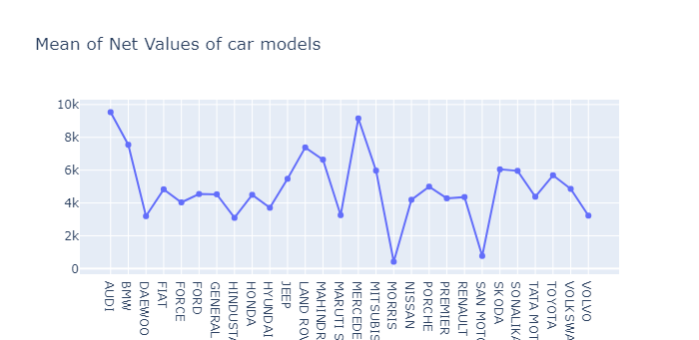
Which make/car is more popular?

Slide 9
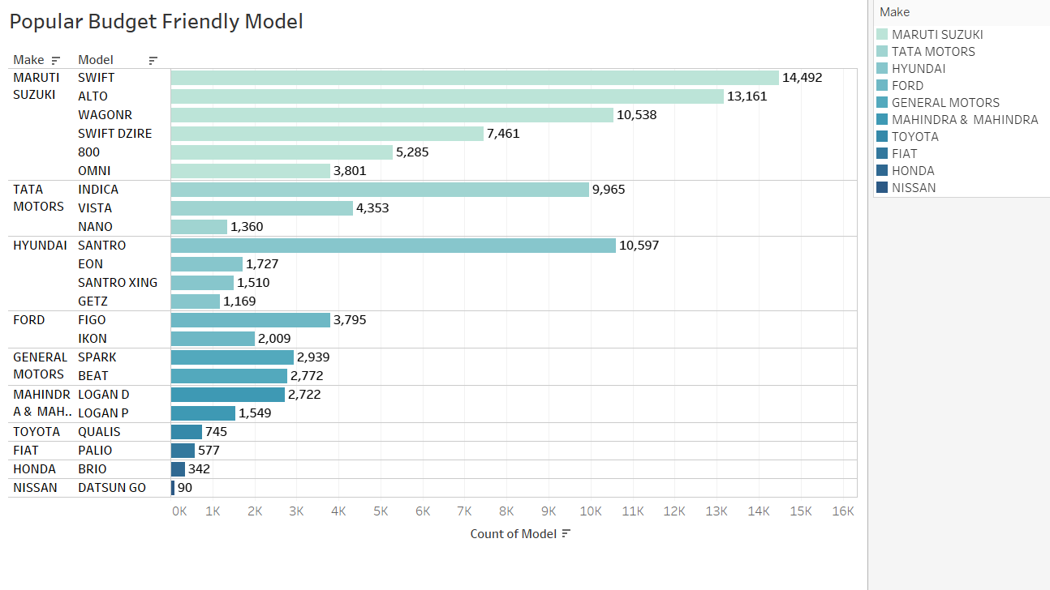
Popular Budget Friendly Car Models

Slide 10
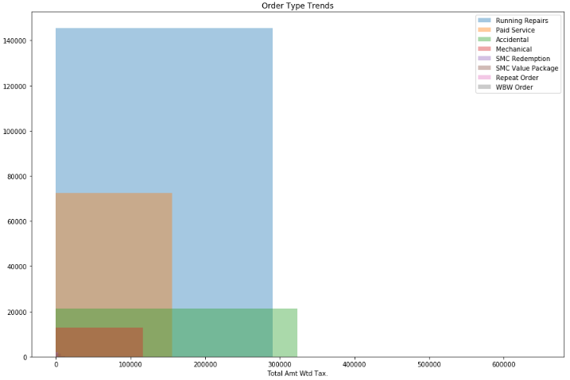
What are the most popular services?
Frequency of Running services customers is highest.
Accidental service order generates highest revenue.

Slide 11
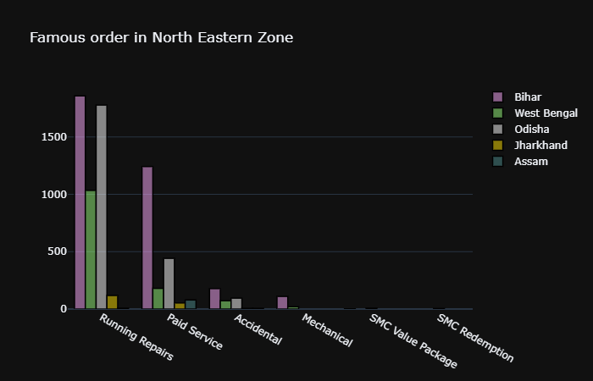
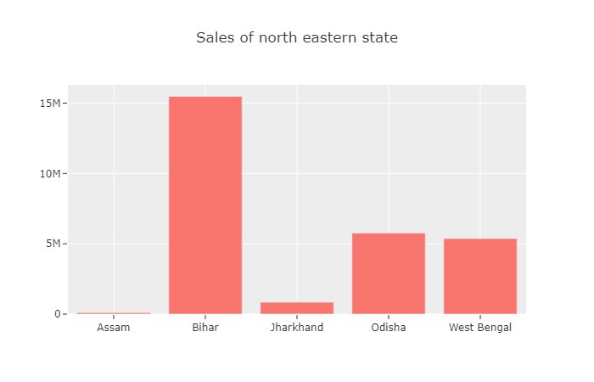
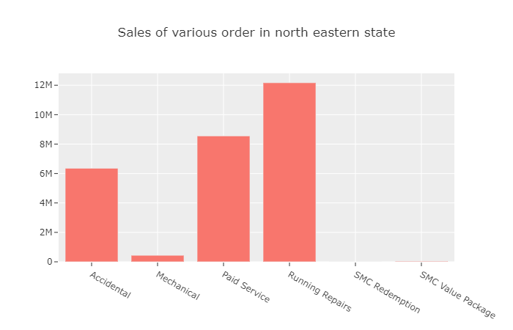
Zonal Analysis
Northern Eastern Zone Service Count

Slide 12
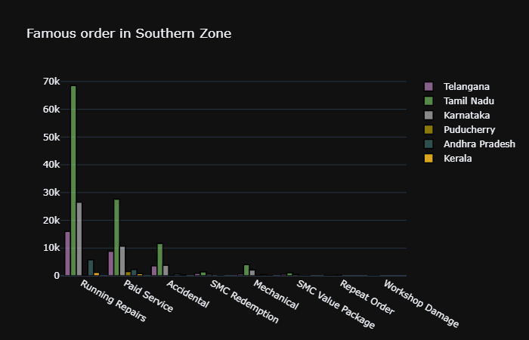
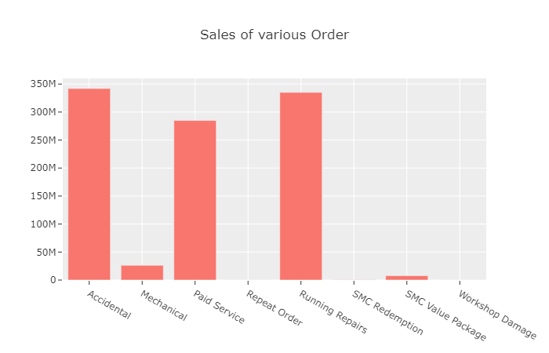
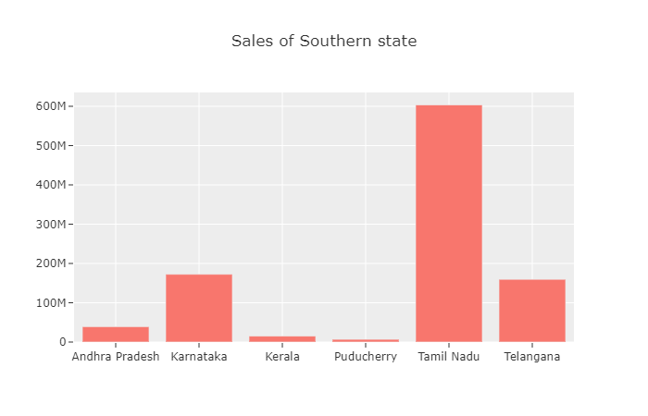
Zonal Analysis
Southern Zone Service Count

Slide 13
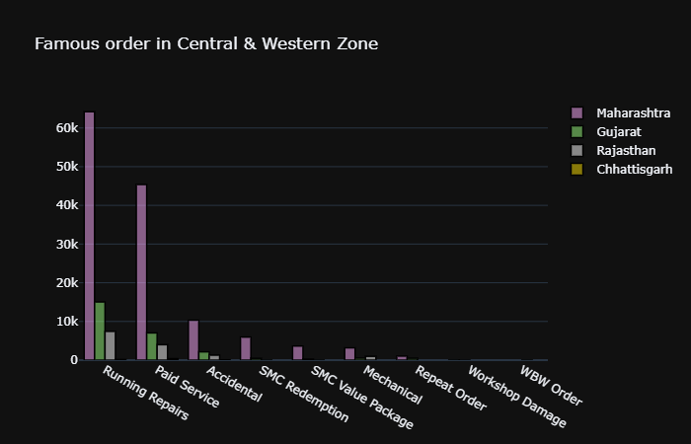
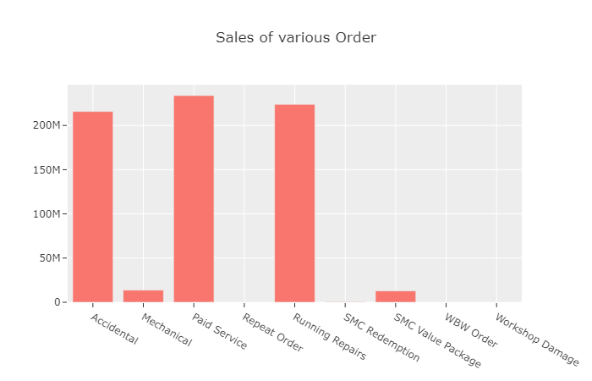
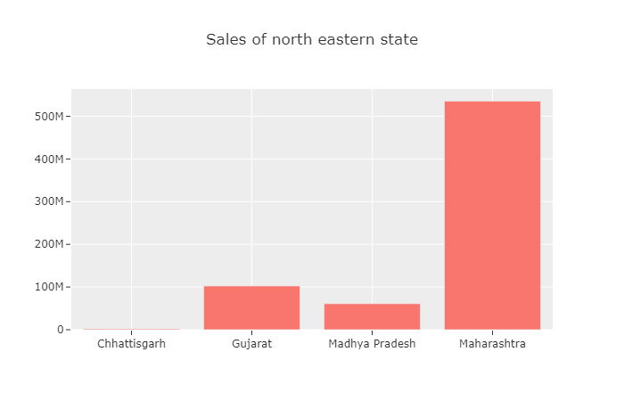
Zonal Analysis
Central & Western Zone Service Count

Slide 14
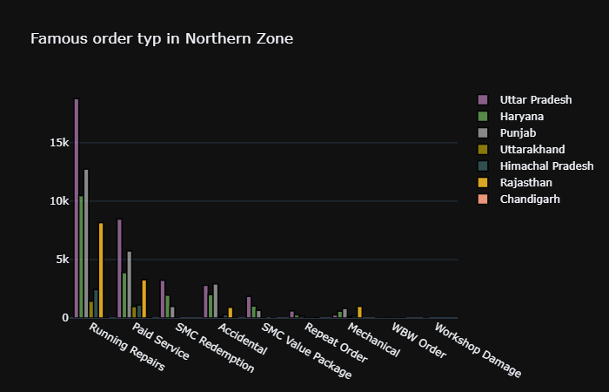
Zonal Analysis
Northern Zone Service Count

Slide 15
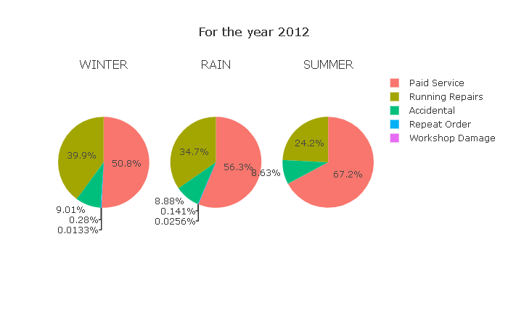
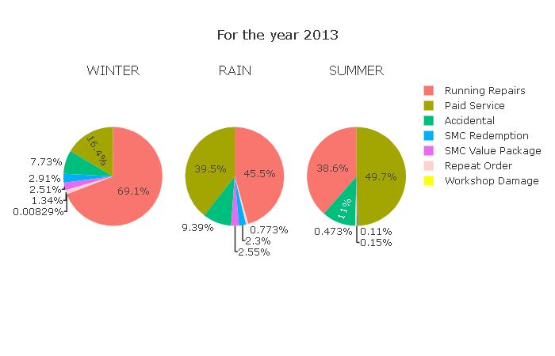
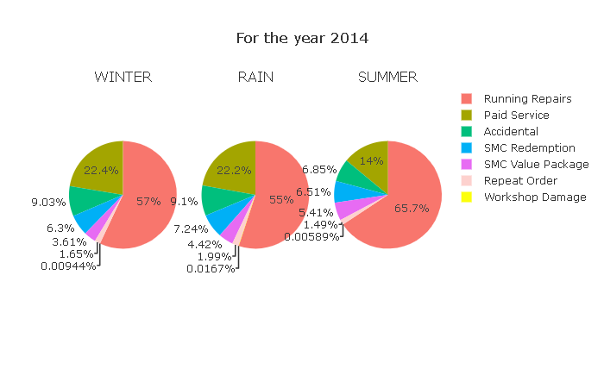
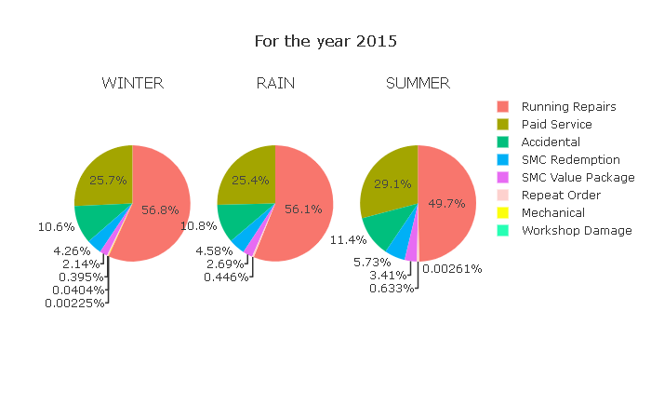
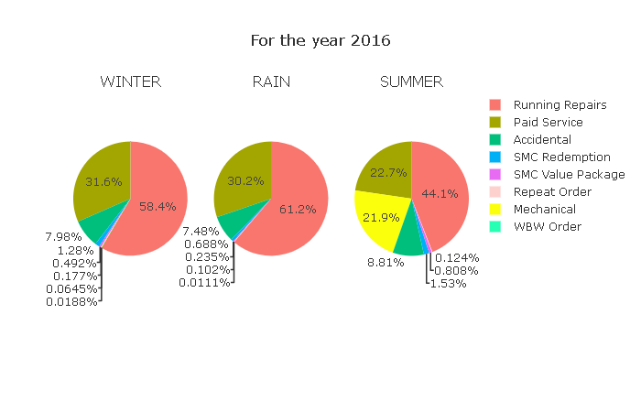
Seasonal Analysis of order types

Slide 16
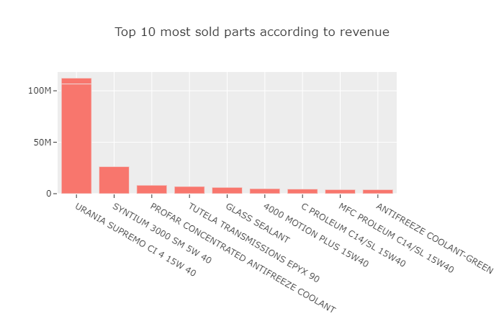
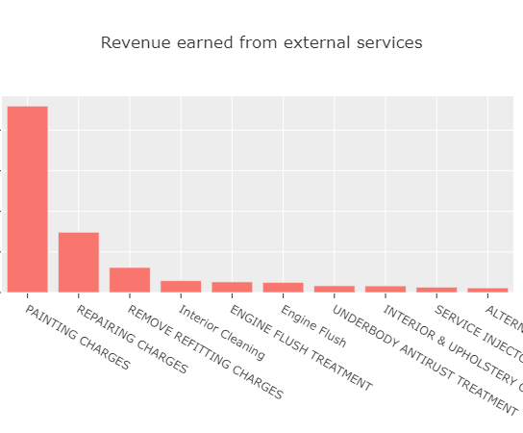
Inventory management analysis for revenue based top 10 parts used and services

Slide 17
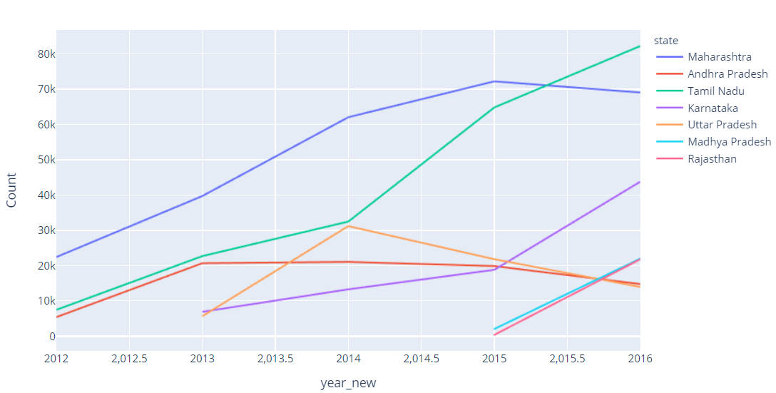
Revenue Analysis State wise Invoice count

Slide 18
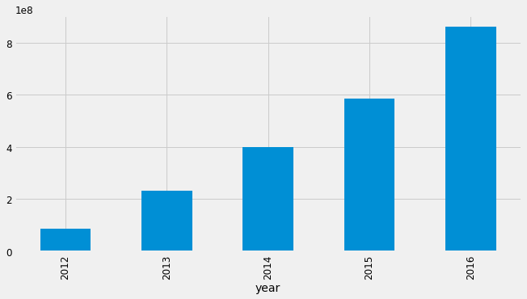
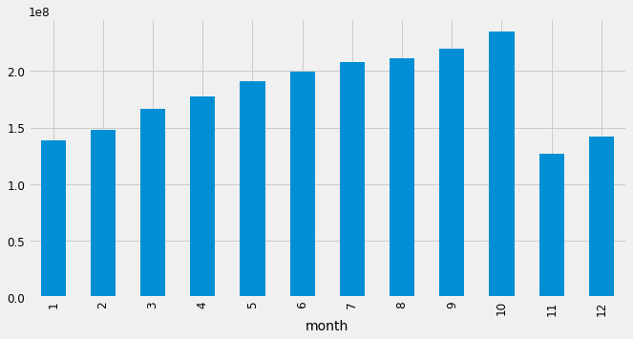
Revenue Analysis trends based on year and months
Year Wise Revenue
Month wise Revenue

Slide 19
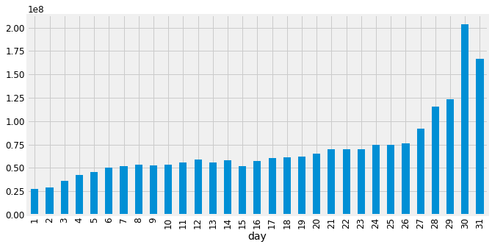
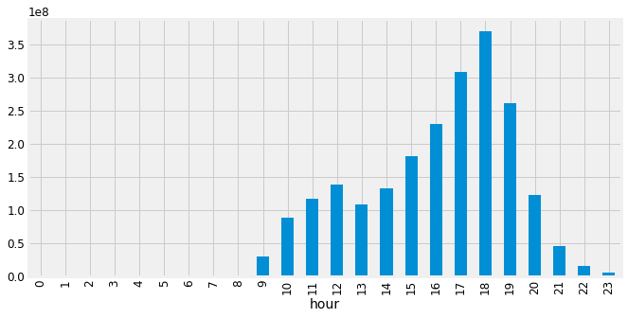
Revenue Analysis hourly and daily sales
Daily Sales
Hourly Sales

Slide 20
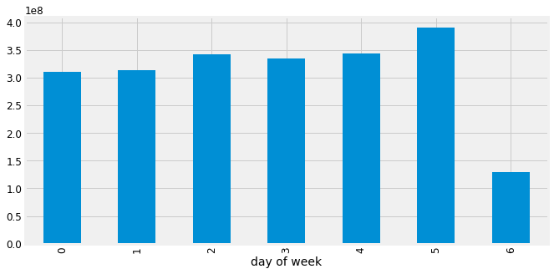
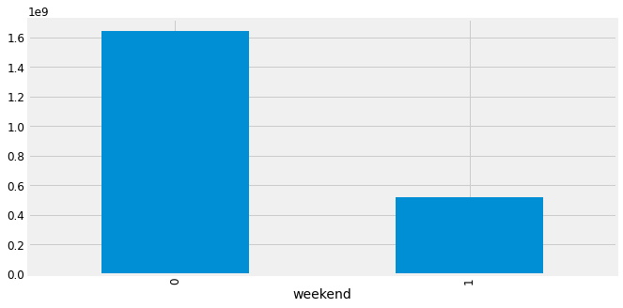
Revenue Analysis daily and weekends
Daily Sales Analysis
Week day vs Weekend Sales

Slide 21
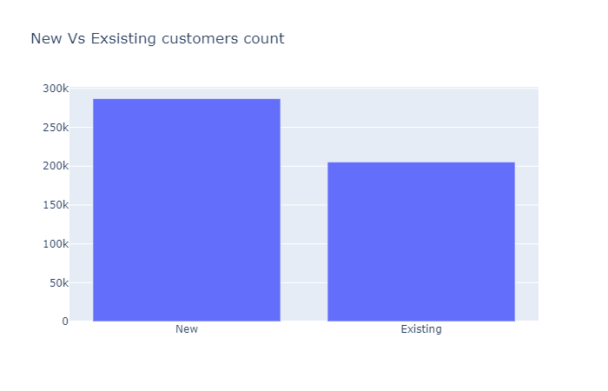
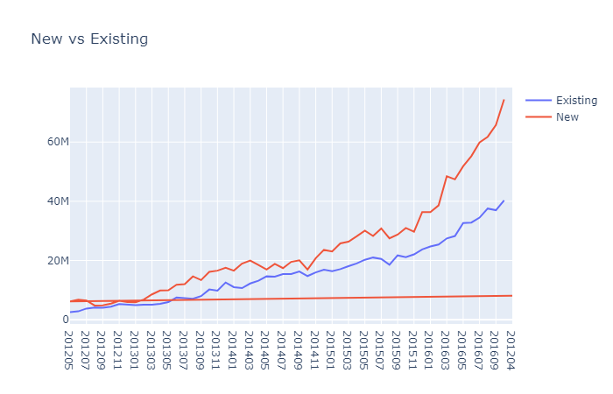
Customer segmentation Analysis Sales contribution from new vs existing customer

Slide 22
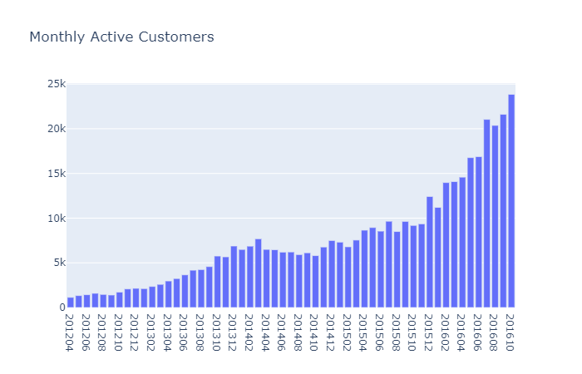
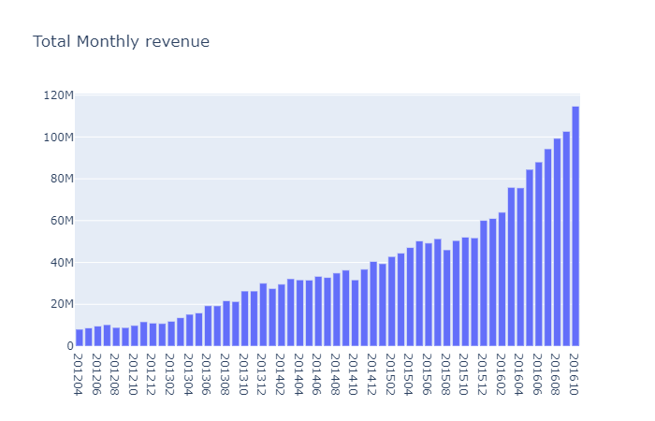
Customer segment analysis Revenue Trends and active customers
Monthly Revenue

Slide 23
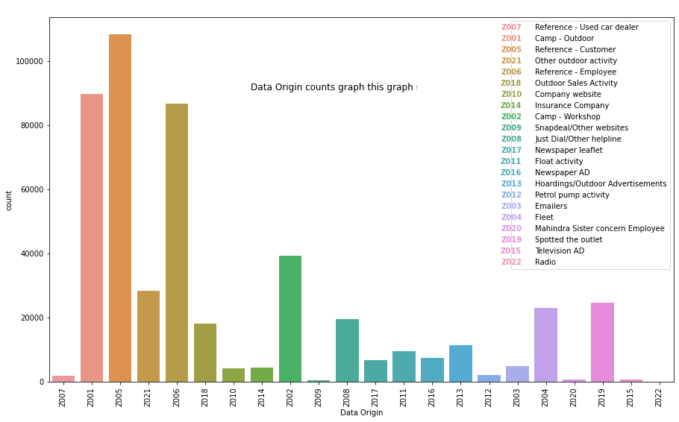
Custer reference sources

Slide 24

Market Segmentation
Lets Start with clustering of data

Slide 25
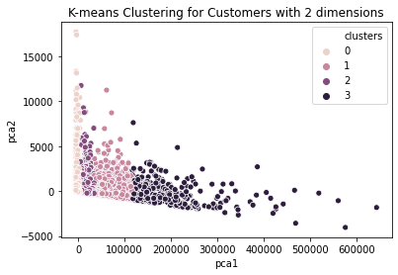
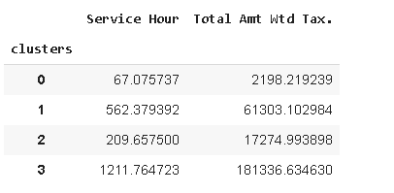
Customer clustering based on revenue
0-low revenue earning cluster of customer 1-high revenue earning cluster of customer 2-medium revenue earning cluster of customer 3-very high revenue earning cluster of customer
Notes:
df_clus =tx_data.groupby(['Customer No.','Make','Order Type'])['Service Hour','Total Amt Wtd Tax.'].mean().reset_index()

Slide 26
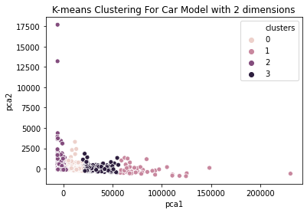
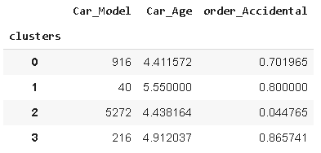
Customer clustering based on Clustering for Revenue generated from different Car Models
0 - Medium Revenue Earning Cluster of Car Models
1 - Very High Revenue Earning Cluster of Car Models
2 - Low Revenue Earning Cluster of Car Models
3 - High Revenue Earning Cluster of Car Models
Notes:
df_clus =tx_data.groupby(['Customer No.','Make','Order Type'])['Service Hour','Total Amt Wtd Tax.'].mean().reset_index()

Slide 27
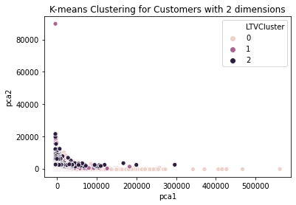
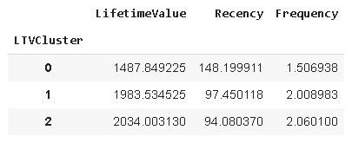
Customer LTV custer
0-low lifetime value of a customer 1-medium lifetime value customer 2-high lifetime value of a customer
Notes:
df_clus =tx_data.groupby(['Customer No.','Make','Order Type'])['Service Hour','Total Amt Wtd Tax.'].mean().reset_index()

Slide 28

Data Preprocessing
Lets Start with preprocessing of data

Slide 29
Data Preprocessing
Dropped columns
Clean state and city names
Treated null values in model, data origin and Partner type column
Bucketed states in zones
Created year, month and season features
Calculated total service hours
Calculated age of the cars
Scraped car prices for bucketing models into Categories

Slide 30

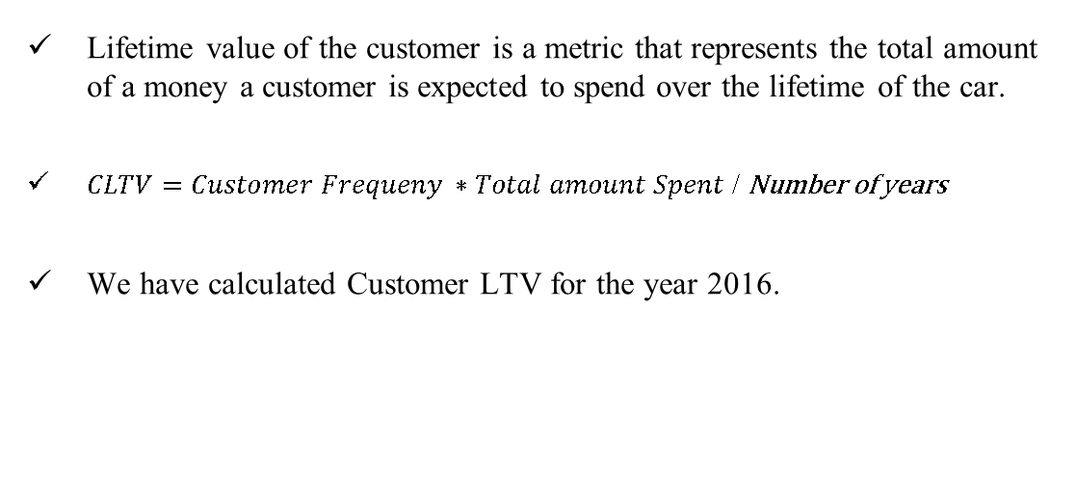
Customer Lifetime Value
Lifetime value of the customer is a metric that represents the total amount of a money a customer is expected to spend over the lifetime of the car.
$CLTV=Customer Frequeny ∗Total amount Spent$ / Number of years
We have calculated Customer LTV for the year 2016.

Slide 31

Modelling
Lets Start with Model Building

Slide 32
Modelling
Models | Accuracy on train | Accuracy on test
Decision Tree Classifier | 0.995 | 0.857
Random Forest Classifier | 0.9222 | 0.9187
Logistic Regression | 0.921 | 0.918
Decision Tree Classifier with Grid search | 0.895 | 0.857
Classification Output:
Low LTV group (<1700)
Mid LTV group (1700 to 2000)
High LTV group (>2000)

Slide 33
Cross Valdiation
We perform cross validation based using voting classifier
Models used for estimators Decision Tree Classifier + Logistic Regression | Accuracy of Voting(Hard) | Accuracy of Voting(Soft)
Train set | 0.922 | 0.995
Test Set | 0.918819 | 0.859333

Slide 34
Actionable Insights
States like Karnataka ,Tamil Nadu and Madhya Pradesh had huge spike in customer base every year. Implement their marketing strategies in states with low customer count
Investigate the reasons for dip in revenue of Uttar Pradesh and Telangana
Eastern states have a significantly lower share of the revenue. This is due to low customer count from these states. More plants could be opened up in this states and marketing strategies similar to top states could help increase the customer base in eastern states.
Majority of cars visiting the workshop are of these 4 brands – Maruti Suzuki, Hyundai, M&M and Tata Motors. Inventory should be stocked up accordingly.
Though invoice of Accidental cases are less, they contribute the largest share to the revenue. Average service time is also the highest. To reduce the same, spare parts of top brands stated above could be stocked up in advance.
The top marketing source has been Customer Reference. We could arrange rewards programs for customers sharing positive testimonials to increase the customer base.

Slide 35

Thank you

